Slide 1
Copyright for Startups
Session 1: Copyright Roots
O’Reilly Tools of Change for Publishing
2012
Skott Klebe
Copyright Clearance Center
sklebe@copyright.com
Twitter: @skottk
Ed Colleran
Copyright Clearance Center
ecolleran@copyright.com

Slide 2
Session 1:
Roots and Reality
of Copyright
Notes:
I’m Skott Klebe. I came to Copyright Clearance Center in 1999 at the height of the dot-com boom to lead development of Rightslink, CCC’s point of content licensing program. We had to surmount any number of technical challenges back then, but above all else we had to figure out how to represent unique and complex licensing agreements in a system that could scale to the needs of big news sites. It was my second time around at CCC, and my second big rights database. I’ve spent most of the last decade on the technical and business teams that rethink the way we store and process rights. Last year I spoke here at Tools of Change about ebooks and disruptive change in publishing.
Today I’m going to lead us all through a study of copyright that focuses particularly on what copyright means to innovative businesses in a time of change. We’re going to start off by looking at how copyright works in the US, then we’ll take a tour of copyright overseas. We’ll look at businesses that have had success leading change in copyright, and some that didn’t. Then we’ll bring it home to cases effecting book publishing today.

Slide 3
A Copyright Story
UMG et al. v. MP3.com
Notes:
We’ll start with a copyright story. Shortly after I came back to CCC, a case came up that really intrigued me. I got into a lot of arguments about it with our copyright lawyers.
The case was UMG – Universal Music Group – and other record companies against mp3.com, a hot startup that was all over the news in those days. Grappling with this case is how I first started to learn how to think about copyright.

Slide 4
Founded in 1997 by Michael Robertson
  Ad-supported search engine for music files
IPO in 1999
  Raised $370 million
  on $1.4 million revenue!
MP3.com
“In the music industry being cool or hip can go a long way…
This company has a lot of momentum.”
-CNET, July 21, 1999
Notes:
Before iTunes, before the iPod, when the Diamond Rio still stalked the earth, there was MP3.com.
People wonder whether we’re living through a new dot-com bubble now, but look at these numbers.
And this analyst quote from the day of the bubble – that’s the way we talked about startups in those days.
MP3.com had an aggressive approach, and saw its role as revolutionizing the business of music.

Slide 5
My.MP3.com and Beam-It
MP3.com launched new services
Instant Listening Service
  Immediate streaming of CD’s purchased through MP3.com and partners
My.MP3.com
  Register your CD collection
  Beam-It software verifies physical CD
  Download your music onto additional devices
January 12,
2000

Slide 6

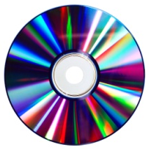
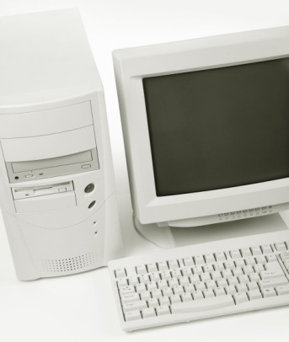
How MyMP3.com and Beam-It Worked
Ripped them into their database
My.MP3.com
Database
Customer downloads onto other devices
(Along with an identifying fingerprint)
MP3.com bought
thousands of CD’s
Customer scans CD with Beam-It
Notes:
(click through)
This is great, because who wants to carry a CD cabinet around?
It’s like your music is just sitting up in a cloud somewhere, and you can pull it down wherever you want.

Slide 7
“…Eventually consumers may not even want to bother buying the physical CD, preferring … online storage space instead.”
“ ‘No, we don’t expect to be sued.’ ”
-Wired, January 12, 2000
Notes:
It’s important to note that mp3.com appeared to believe that they were behaving correctly – that they were pushing the envelope, but were not only staying within the bounds of copyright, but causing no harm to anyone, either.

Slide 8
The Short Life of MP3.com Instant Listening
Instant Listening launched:
January 12, 2000
MP3.com sued by UMG et al.:
January 21, 2000
Summary judgment in favor of UMG:
April 28, 2000
Partial summary judgment in favor of RIAA:
April 28, 2000
Notes:
Anyone remember how long it took for them to get sued?
And who won?
This was a devastating turn of events for MP3.com, but I don’t think that it was unpredictable.

Slide 9
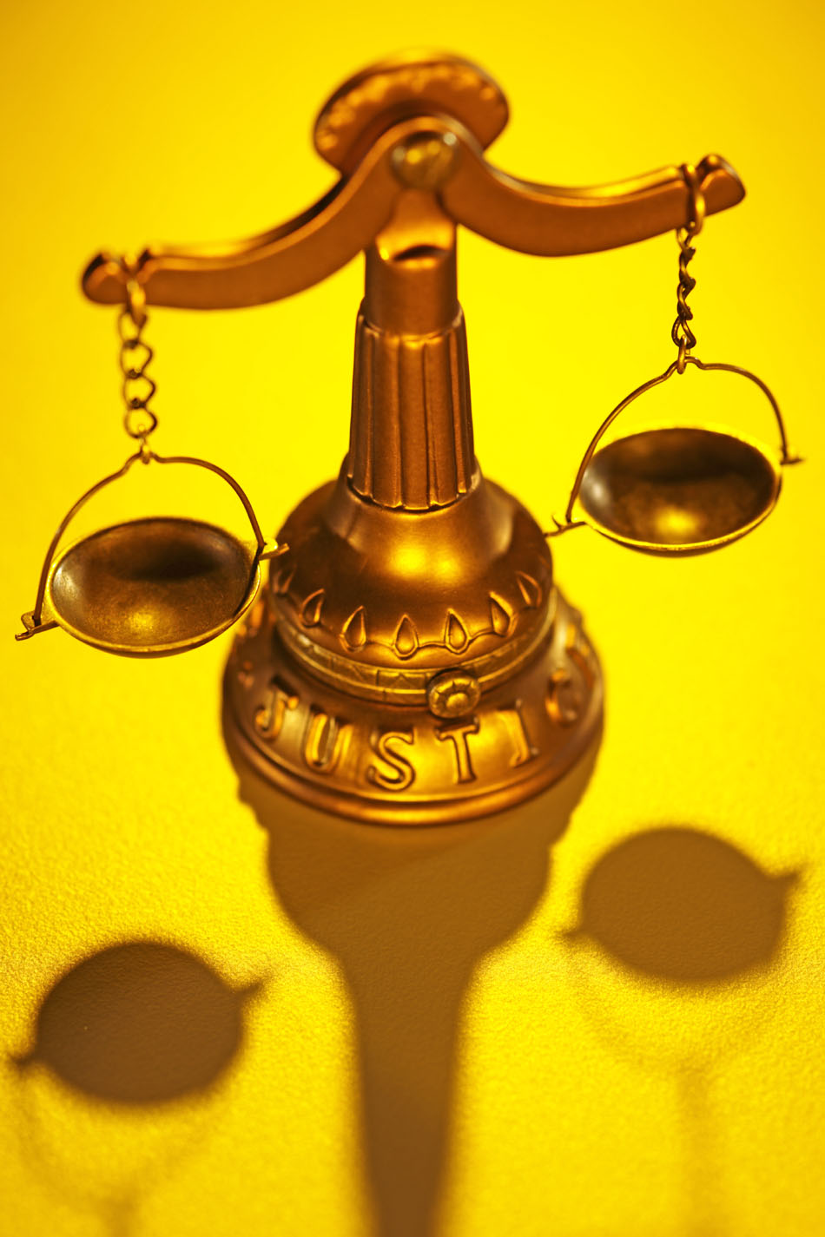

Copyright and Technologists
Notes:
Over the years, in the news and first-hand, I’ve seen people in technology businesses try to apply technical insight to matters of copyright law.
Understanding copyright requires learning a particular way of thinking, with its own set of rules.
Technologists are very comfortable working with sets of rules that are written for computers, but copyright rules are different – they’re written for human beings, which are like computers with a lot of independent judgment.
Am I going to run that program?
Here are the reasons for.
Here are the reasons against.
Here’s what other computers in the Second Circuit did in similar situations in the past.
Today we’re going to review a sort of toolkit for understanding copyright.

Slide 10
Program Overview
Copyright origins
What is copyright today?
Fair use
BREAK
International copyright
How copyright changes
Key takeaways

Slide 11
What is copyright?
Notes:
One way to understand the idea is to look toward its origins.

Slide 12
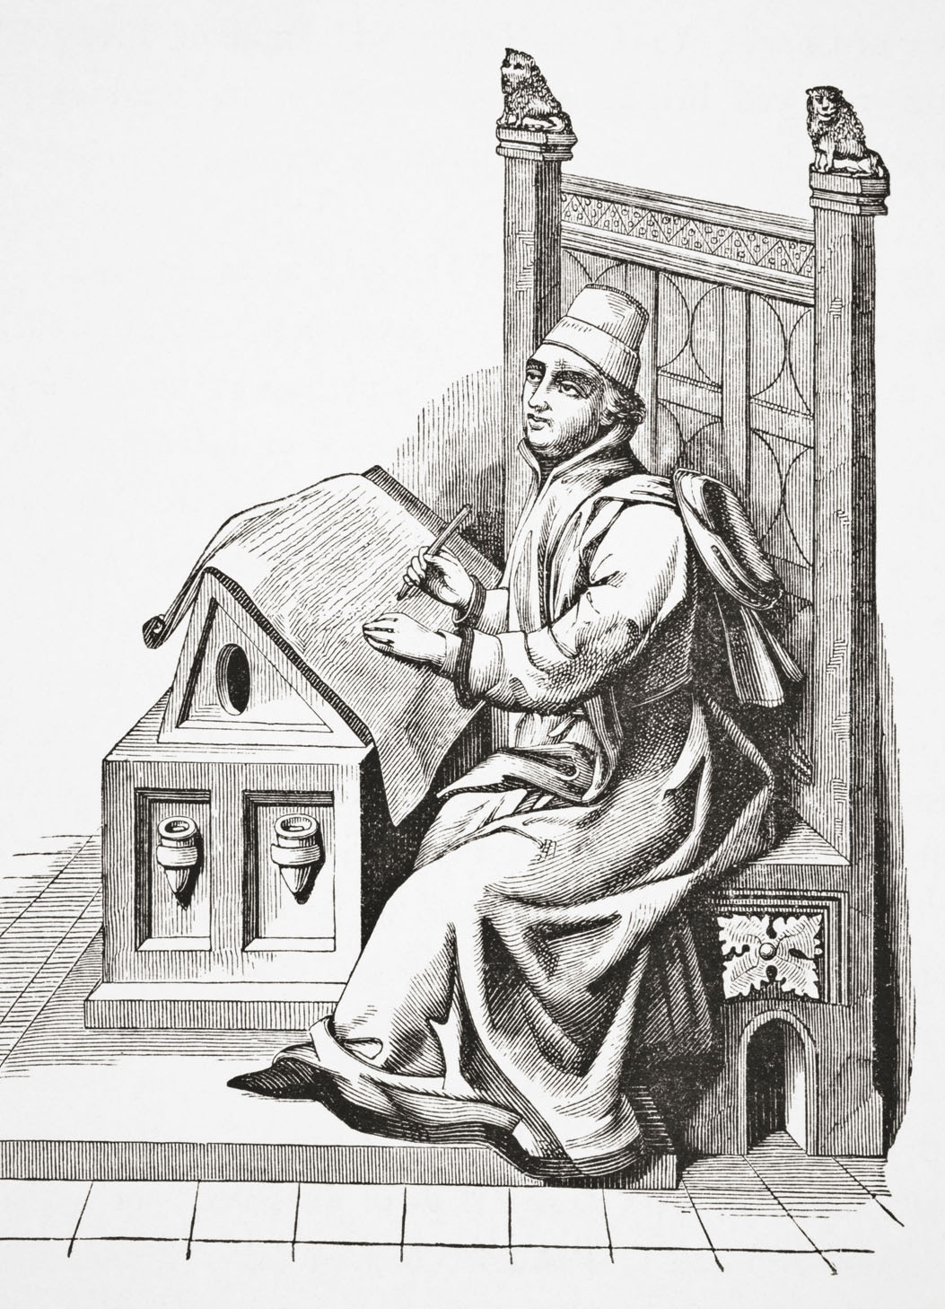
Origins of Copyright
Notes:
Let’s start with some history. We’re not going too far back, even though there are anecdotes about saints in sixth-century Ireland
However, the spirit of copyright law didn’t really emerge until it was relatively easy to make lots of copies of things.

Slide 13
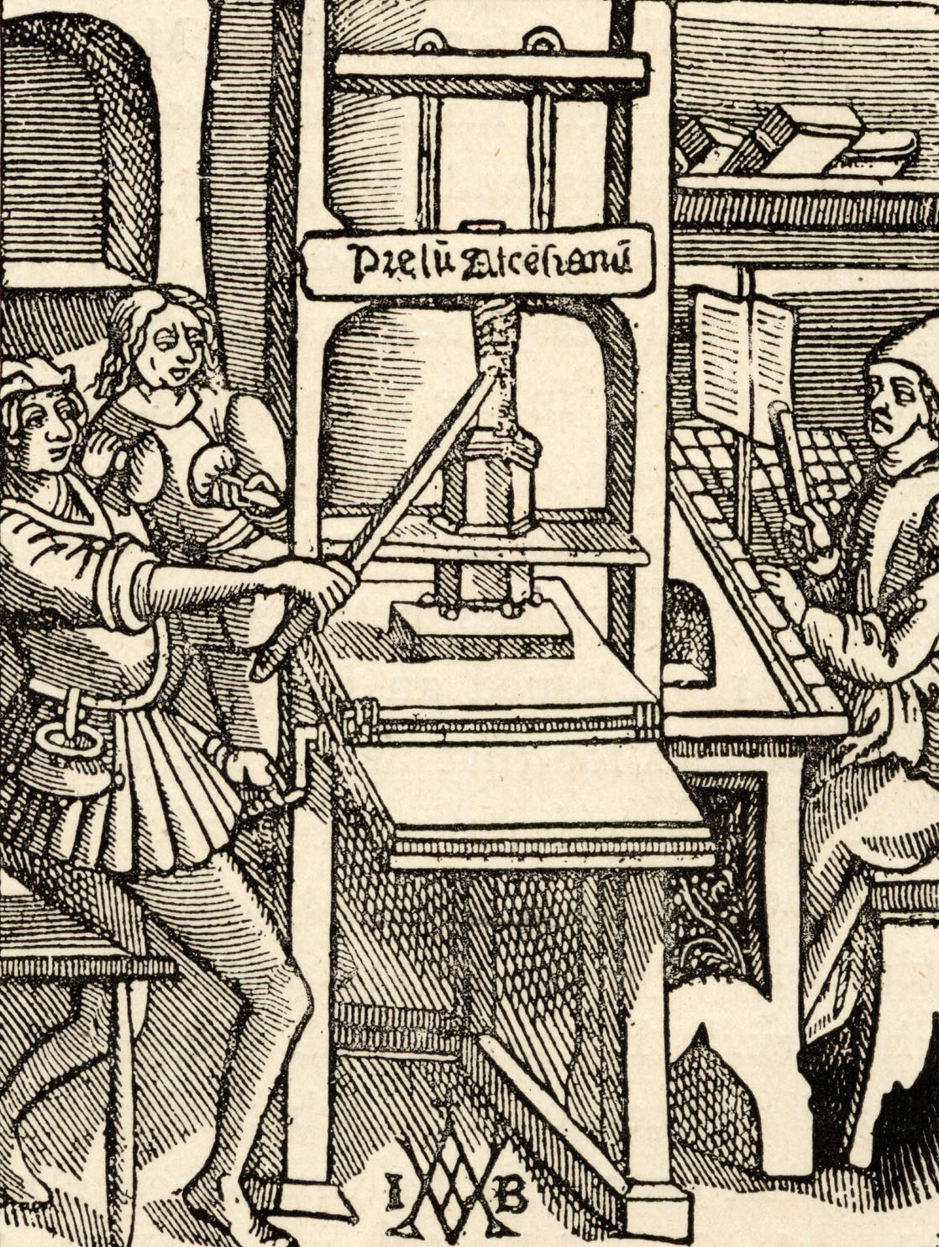
Knowledge Yearns,
nay,
e’en Breathes,
to be Free!
Notes:
The perpetual driver of change in copyright has always been technology.
The technology of printing allowed for multiple exact copies of a work at a marginal cost per copy that was largely nominal.
It was a huge problem! More people could buy books and read them. Where would it all end?
Pope Alexander VI was against it, and tried to forbid unlicensed printing. But then, he was a Borgia.
In the early days of printing, it was common for monarchs to grant monopoly privileges to printers in exchange for some level of control of what they printed.
However, the very availability of printing technology made it difficult to control. Printers developed the radical notion that they ought to be able to print whatever they wanted, with complete disregard for local laws or the preferences of rulers.
Or remuneration of authors, for that matter.

Slide 14
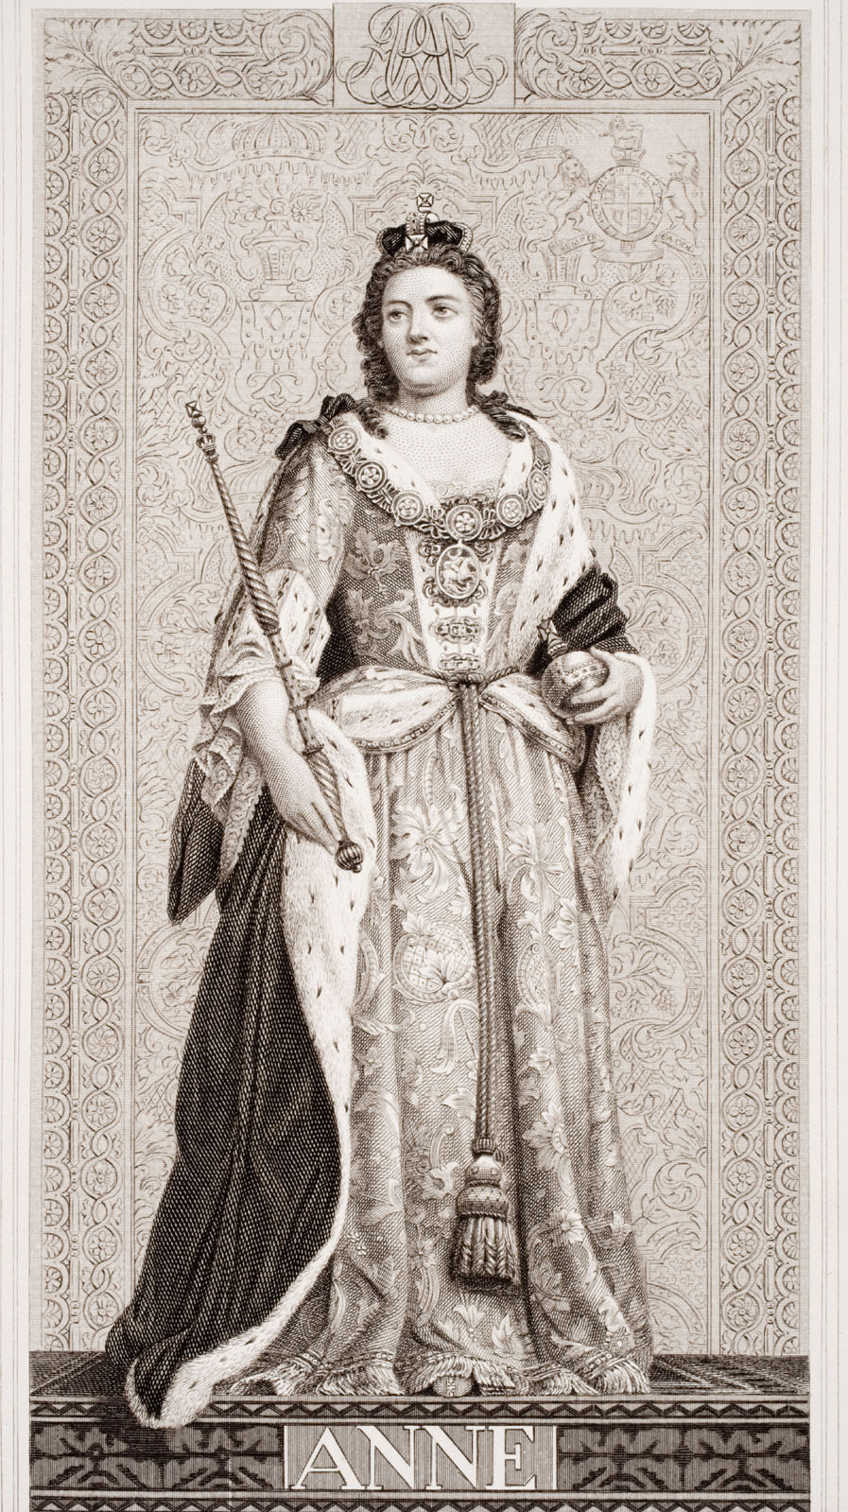
[Also known as the Statute of Anne, 1710]
An Act for the
Encouragement of Learning,
by Vesting the Copies of Printed Books in the Authors or Purchasers
of Such Copies
Notes:
We can see that in the Statute of Anne, the first formal law regarding copyright in the history of the world.
This was before copyright laws were believed to need really good acronyms, or at least ones you could pronounce, like SOPA.
The Statute of Anne placed the control of the work in its creator, but for a limited time only.
Authors owned the right to control the printing of their works for 21 years after their creation.
Three ideas:
the purpose of encouraging learning
the right originating in the author,
and the limited time of that grant – evolved in English case law throughout the century, winding up in the United States Constitution

Slide 15
United States Constitution
Article 1, Section 8, Clause 8
“Congress shall have the power…
“…To promote the Progress of
Science and useful Arts,
by securing for limited Times to
Authors and Inventors
the exclusive Right to their respective
Writings and Discoveries.”
Notes:
In the US, copyright starts with the Constitution, Article 1, Section 8, Clause 8.
So these principles were accepted by a number of countries, but copyright didn’t extend across national boundaries.
Printers in one country could easily snag a book published under copyright in another.

Slide 16
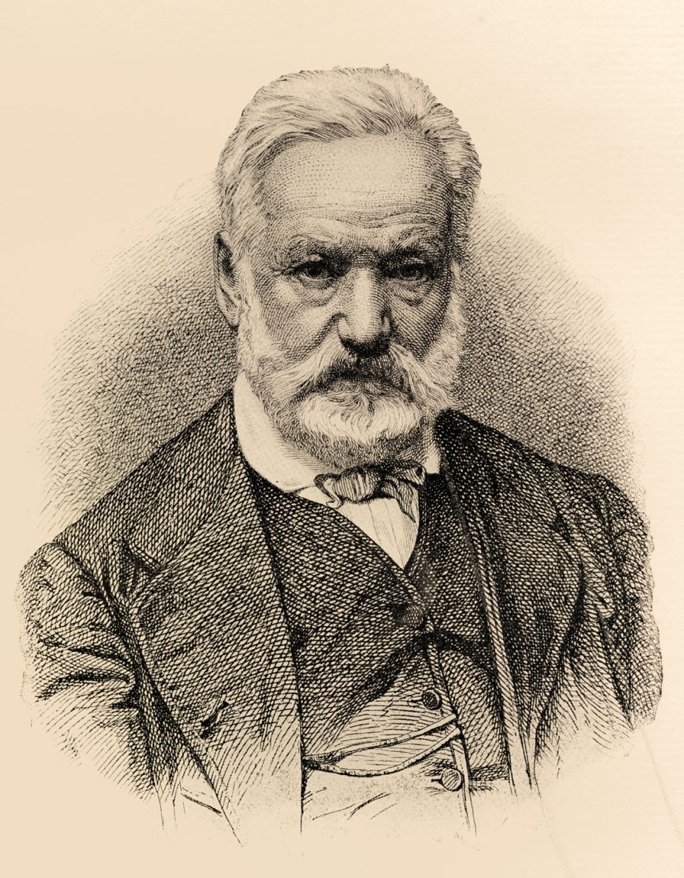
Berne Convention, 1886
Cross-border copyright regime
Author’s rights exist from the
moment of “fixation”
No registration process
required
US did not ratify until 1988
Notes:
The Berne Convention of 1886 sought to establish uniform principles of copyright around the world, replacing an irregular quilt of laws that held only within national boundaries. A French publisher could freely translate and sell copies of a work that was under copyright in England, for instance.
The publishing industry in the US was a particularly voracious unauthorized publisher of foreign works.
This stern gentleman here, Victor Hugo, was one of the major proponents of a unified copyright regime.
Other key highlights of Berne are the elimination of the registration requirement for copyright, so that authors hold all rights in their works from the moment they are fixed, as the phrase goes.
Almost every country in the world has ratified a Berne copyright regime, though some countries took their time.
The United States adhered to its own alternative practices until 1988.

Slide 17
The Berne Principles
National treatment
Automatic protection
Independent protection
Berne Principles
Country A
Law
US Law
after 1988
US Law
pre-1988
Notes:
National treatment – a Berne country must give works from another Berne country the same protections it gives its own works.
Automatic protection – there can’t be a registration requirement to receive copyright protection
Independent protection – A work from country A is independently protected in country B for its full term, even if protection in country A ends.
Berne isn’t a law – it’s a treaty specifying what a compliant copyright regime has to look like. Some countries enacted Berne-compliant copyright law rapidly, but the US took quite a bit longer – it wasn’t until 1988 that US copyright law was modified to comply with the Berne convention.
We’ll go into this in more depth after the break.

Slide 18
US
Copyright
Timeline
Berne Convention, 1886 Copyright Act of 1909 Universal Copyright Convention, 1952 Copyright Act of 1976 Semiconductor Chip Protection Act of 1984 Satellite Home Viewer Act of 1988 Visual Artists Rights Act of 1990 Architectural Works Act of 1990 Computer Software Rental Act of 1990 Semiconductor Internation Protection Extension Act of 1991 Audio Home Recording Act of 1992 Satellite Home Viewer Act of 1994 Digital Performance Right in Sound Recordings of 1995 Sonny Bono Copyright Term Extension Act of 1998 Digital Millennium Copyright Act of 1998 Digital Theft Deterrence and Copyright Damages Improvement Act of 1999 Technology, Education and Copyright Harmonization Act of 2002 Small Webcaster Settlement Act of 2002 Artists’ Rights and Theft Prevention Act of 2005 Family Movie Act of 2005 Preservation of Orphan Works Act of 2005 Vessel Hull Protection Amendments of 2008 Webcaster Settlement Act of 2008 Webcaster Settlement Act of 2009 Copyright Cleanup, Clarification, and Corrections, Act of 2010
Notes:
But that was just one of a huge number of changes to US copyright law over time.
Let’s take a look at some of the legislation that has shaped copyright in the United States today. We start off with the Berne Convention, as we just mentioned, and then…
Hey, what’s happening here?
We can see that there has been just a huge volume of legislation affecting copyright in recent years. Semiconductors, digital this, webcasting that, audio recording, boat hulls… Boat hulls?
But this shouldn’t surprise us – copyright law has always been driven by technology, and technology has been changing very rapidly.
Let’s focus on what copyright means for us today.

Slide 19
Our copyright focus in this overview:
US Copyright as defined in
Copyright Act of 1976,
  Superseding the Copyright Act of 1909
As modified by Berne Convention Implementation Act of 1988
And augmented by the Digital Millennium Copyright Act of 1998
Notes:
We’re not going to talk about semiconductors, juke boxes, or boat hulls today, even though all of these have been treated under current copyright law in one way or another.

Slide 20
In other words…
What can receive copyright protection?
What does copyright consist of?
When does copyright apply?
And when not?

Slide 21
Let’s see what the law says copyright applies to.

Slide 22
Original works of authorship
  fixed in any tangible medium of expression,
    now known or later developed,
    from which they can be
      perceived,
      reproduced,
      or otherwise communicated,
        either directly
        or with the aid of a machine or device
17 U.S.C. § 102
Notes:
The language in the law is extremely general, and intended to provide for technological change.
The core ideas are originality – that there’s something new in the work, not that it’s wholly novel, and that it’s created by an author. Not things that are wholly random, or are unmodified reproductions of facts, or that exist in nature.
Fixed in a medium of expression – ideas, procedures, methods, concepts, principles, and discoveries are explicitly excluded. Copyright doesn’t protect things that aren’t fixed, or that are useful. Like spoons, or other tools.
Perceived, reproduced – the means by which works are disseminated
Machine or device – that dissemination occurs through technical means is irrelevant. The 1909 act allowed an interpretation that a player piano roll that recorded a particular piano performance was not an unauthorized copy, because it wasn’t directly perceptible by a human being. Under current law, a copy that’s digitally compressed, encrypted, chopped into a billion pieces and then reassembled, is still governed by copyright law as long as there’s a way to reproduce or re-perceive the original work.

Slide 23
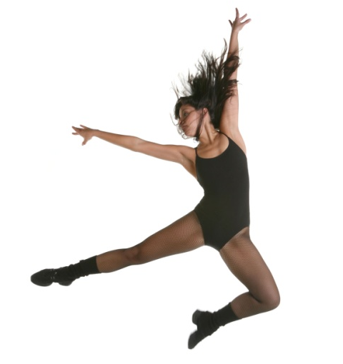

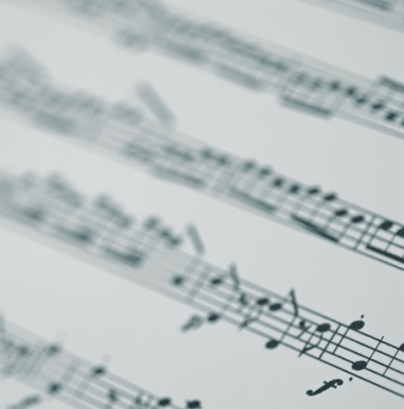

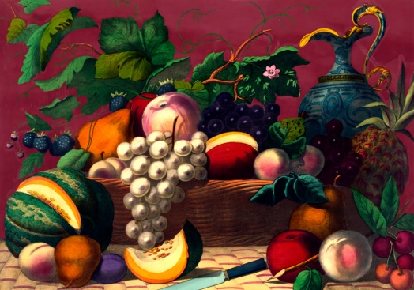
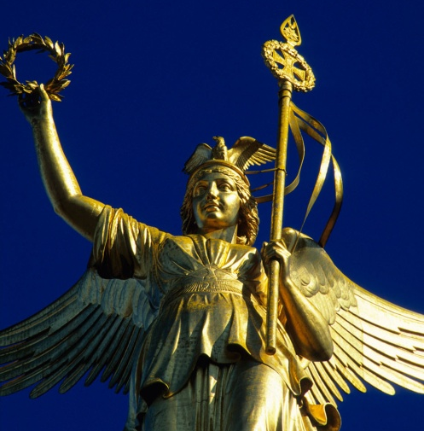
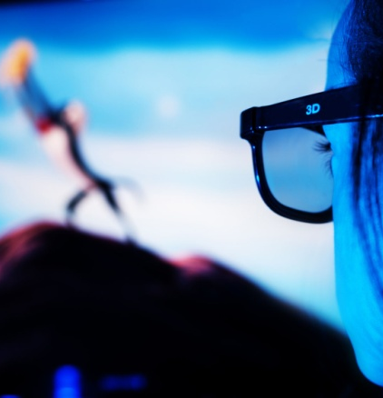
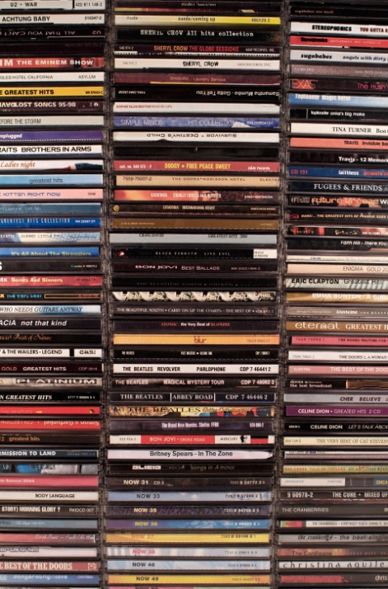
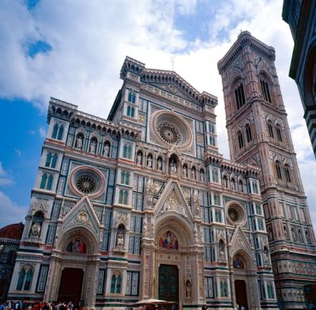
What kinds of work can receive protection?
17 U.S.C. § 102
Notes:
Section 102 of the Copyright Act says, works of authorship fixed in any tangible medium, now known or later developed. This includes:
Literary works
Musical works, including accompanying words
Dramatic works, including accompanying music
Pantomimes and choreographic works
Pictorial, graphic, and sculptural works
Motion pictures and other audiovisual work
Sound recordings, which also have some
Architectural works
Here’s a little more detail on some of those.

Slide 24

Literary works
Books
Articles
Poems
Software
Printed or prerecorded speeches
Expressions of numbers, letters, or symbols that aren’t musical or audio-visual
17 U.S.C. § 102
Notes:
Literary works – this is a considerably more general use of the word literary than even in the phrase, “literary agent.” Literary here is interpreted as including everything that consists primarily of text, or even things that look like text. Software, for instance, is a literary work in this sense.
The actual legal definition talks about expressions made out words, numbers, symbols- other than musical or audiovisual works
A totally impromptu speech isn’t in general covered, because it’s not fixed in tangible form.

Slide 25
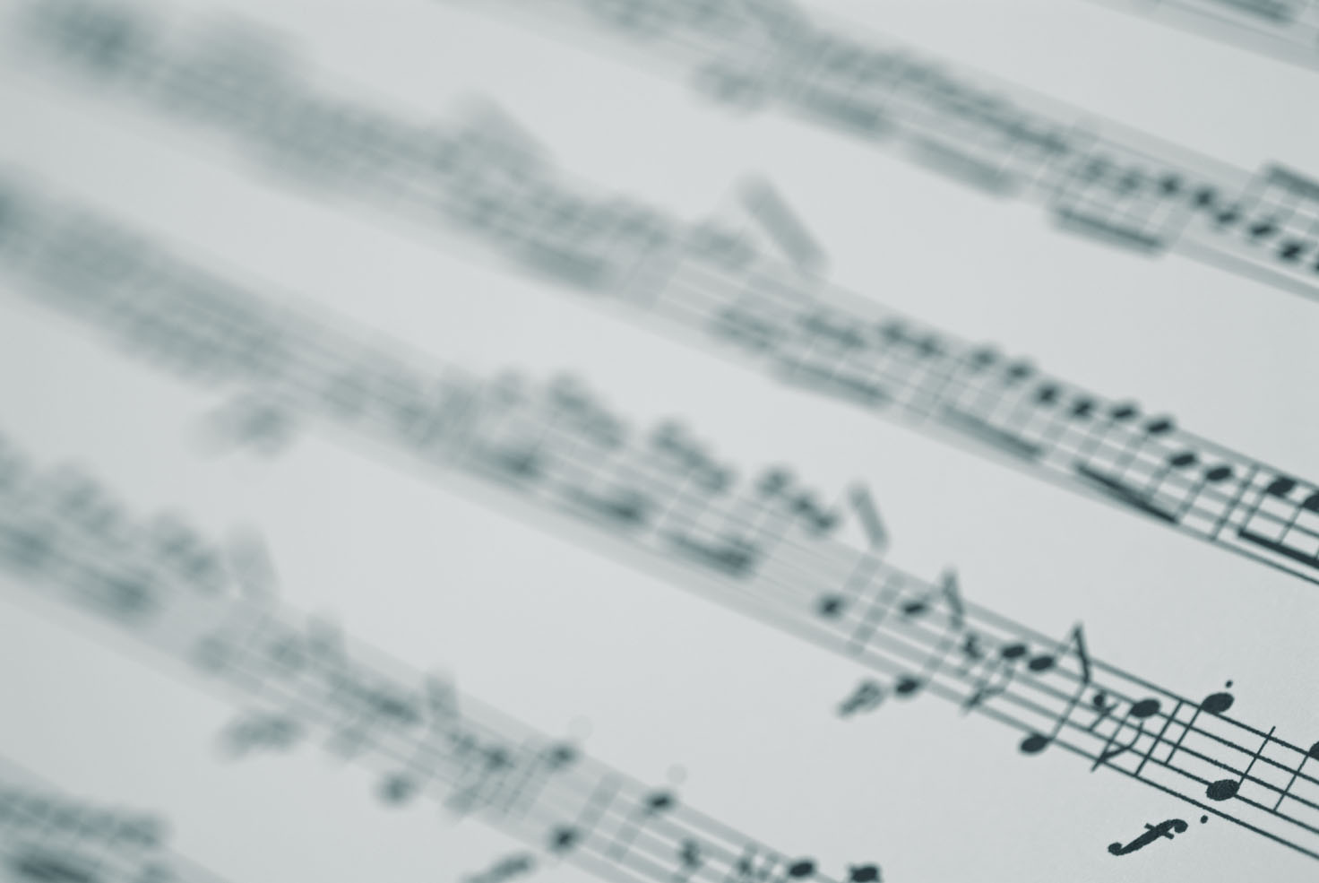
Music, including accompanying words
Music compositions
Songs, with lyrics
Not just a recording of a song, but the song itself
Notes:
Musical works, including accompanying words – this is the actual song or composition itself, not just a recording of a particular performance. Sound recordings are handled separately
I’m using a picture of sheet music, but that doesn’t mean that that the musical work needs to be written down in traditional musical notation.
The composer of the music and the author of the lyrics are often not the same person, but those products come together in a single work – the song. Here in the Copyright Act, the music and accompanying words are bundled together.

Slide 26

Dramatic works, including accompanying music
Portrays a story
  Dialogue or acting
  Intended to be performed
Overlaps with the Music clause
17 U.S.C. § 102
Notes:
Plays, operas, musicals
Handel’s Messiah is a musical composition without characters, stage directions, or a story to be performed – so it’s music, not a dramatic composition. Of course, it’s in the public domain!
An opera, on the other hand, has characters, stage directions, and a story to be performed, so it would be a dramatic composition.

Slide 27
Pantomime and choreography
Pantomime
  Significant gestures, with or without words
Choreography
  Specific performer movements
  Need not tell a story
  Often recorded in notation or film
    in order to receive copyright protection
17 U.S.C. § 102, Nimmer
Notes:
Pantomimes and choreographic works – This isn’t just conventional mime – think of it as a silent drama. Similarly, just improvised dancing isn’t fixed in form, and isn’t inherently copyrightable. Something like the Electric Slide, though – there you’re on shaky ground.

Slide 28
Pictures, Graphics, and Sculpture
Paintings and illustrations
Sculpture
Maps
Photography
17 U.S.C. § 102, Nimmer
Notes:
Copyright in works of art focuses not on the quality of the art, of course, but on the originality and creativity.
What of Duchamp’s bicycle wheel or urinal? The question may be whether the art is expressive, or whether it is purely functional.
Some of Marcel Duchamp’s works were among the most famous and influential works of 20th century art, but their copyright-ability is subject to debate. There is a whole field of art called Appropriation in which works contain or even entirely consist of other works by other artists. In general, though, the fact that a particular work is respected or important does not mean that it is actually able to achieve copyright protection.
Maps have a few interesting points, because much of the information on a map is not expressive or original.
Place names, for instance, are not copyrightable, if they are the real place names. However, the presence of a place name can be used to indicate copying; cartographers will insert fake place names into their maps in order to help prove that another map was copied from their own.

Slide 29

Motion pictures and other audiovisual work
Series of related pictures displayed to create an impression of motion, together with accompanying sounds, if any
17 U.S.C. § 102
Notes:
Bet you didn’t think the definition would have to be that complicated.
Videos, movies and TV programs foster copyright issues like no other kind of work. For one thing, they’re capable of incorporating all of the other kinds of content in the domain of copyright, from music to architecture.
One ongoing objection to Youtube has been the large number of videos that contain copyrighted music. As a result Google has had to develop music-recognition technology to facilitate takedown requests, as well as licensing arrangements.
Even before the digital era, there have been cases about personal use versus public performance, videotaping of TV shows for personal use, and many, many others. In the second session, we’ll discuss a few cases that have been important turning points in copyright history.

Slide 30
Sound recordings
Recording of a performance
  Derivative work
Heavily driven by technology
  One of the earliest cases involved paper rolls for player pianos
Ownership confers no right to the original work
17 U.S.C. § 102
Notes:
Another highly contentious area of copyright, as we know. The CD’s that MP3.com stored on its servers were sound recordings.

Slide 31

Architectural Works
Free-standing structures
Drawings
Models or plans
The overall form, but not individual features.
17 U.S.C. § 102, Nimmer
Notes:
The United States added support for architectural copyright in order to complete its compliance with the Berne Convention. As always, the copyright is on the original, non-functional elements of the work. The decorative or design elements.
In the discussion around adding architectural copyright, there was concern that virtually anything might become eligible for protection.
This building, of course, is in the public domain.

Slide 32
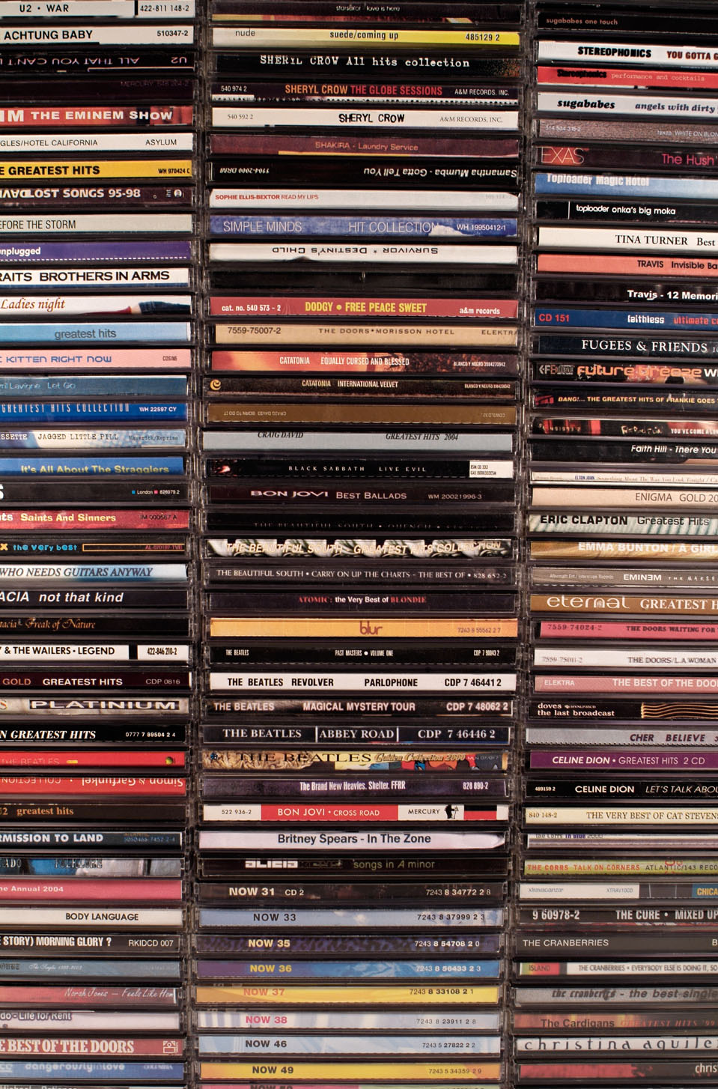


Collective Works
Notes:
Many works are composed of or include examples of many other kinds of works.
Movies - contain songs and choreography, and sound recordings.
- Collective work, can be entitled to copyright protection.
- obvious for a movie
- originality is generous – can be an anthology, because of originality of selection and editing.
Doesn’t confer rights on included works! Need to license.
- Cases where included works prevented further use. WKRP, Eyes on the Prize.

Slide 33
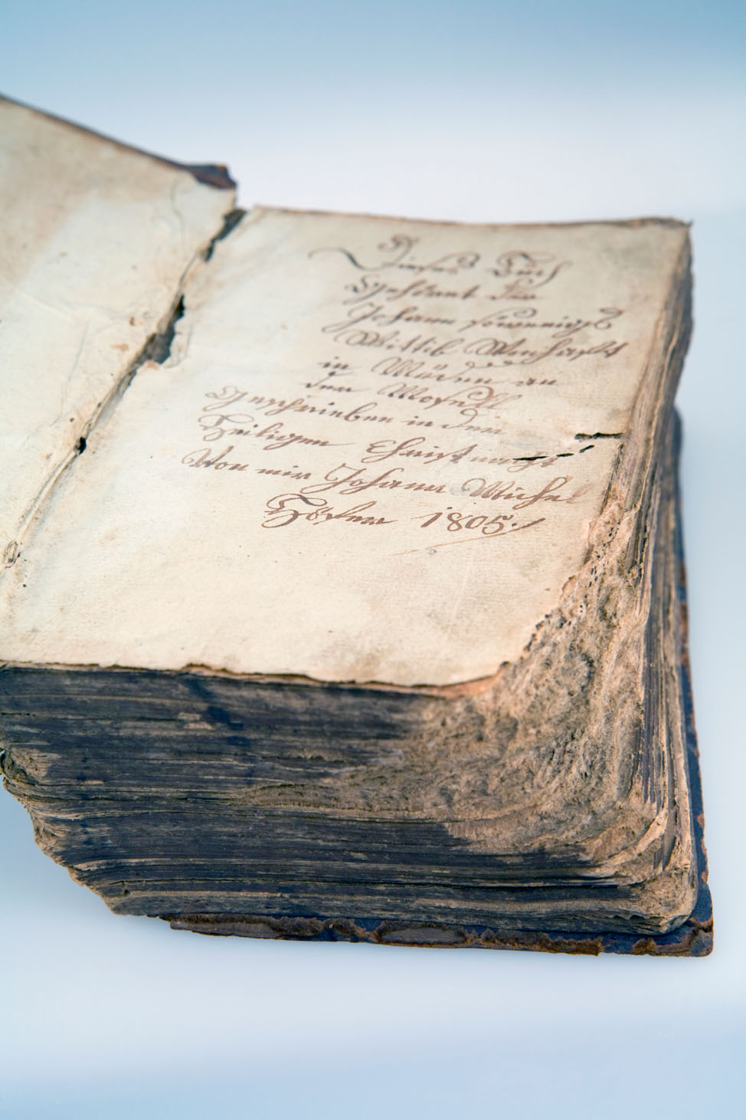
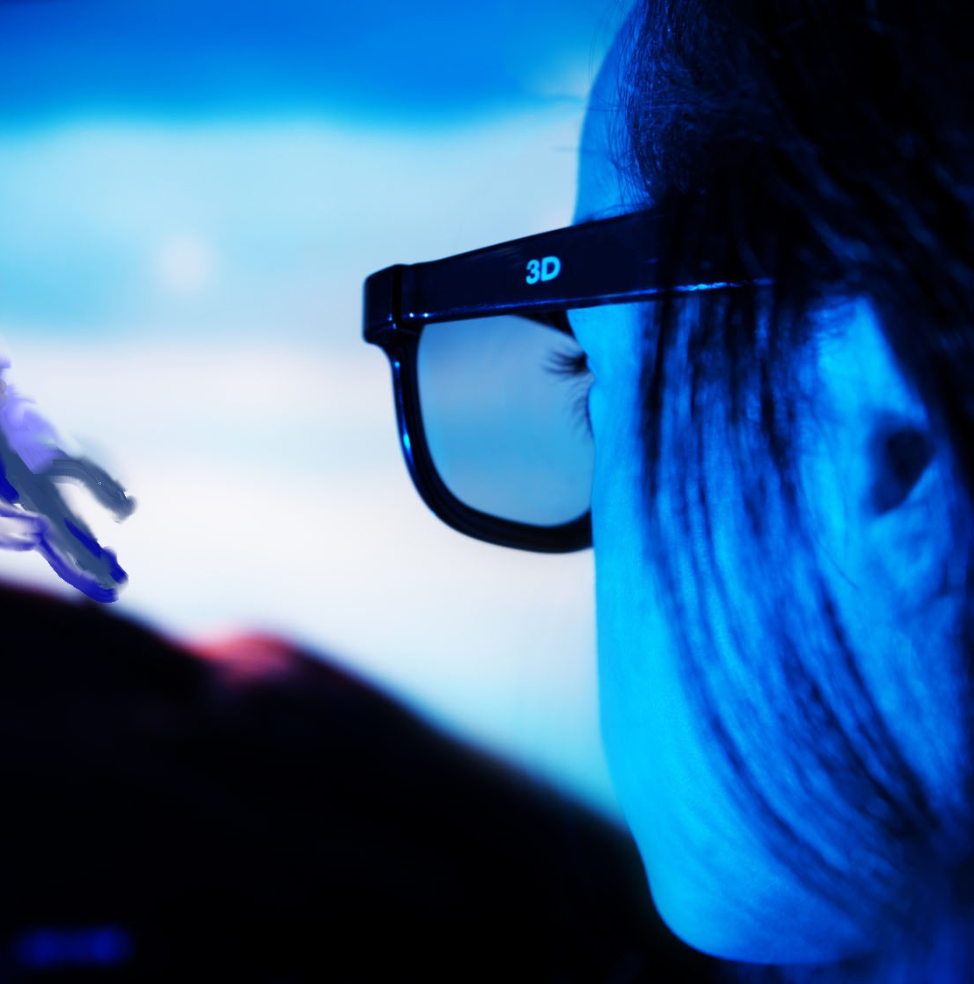
Derivative Works
Notes:
A derived work is based on one or more preexisting works.
Translation, dramatization, recast, transformed, or adapted.
Exclusive rights only in the new material
For works under copyright protection, may need permission!
- Movies from books – new work, protected, but doesn’t mean the movie owns the book.
- Novelization– new work, protected, but doesn’t mean the author/pub sell the right to make a new movie!

Slide 34
Databases
Compilation of material that may not be subject to separate protection
  Including facts
Collection must be original in its selection or arrangement
  Not a simple alphabetized list
Registration is required for enforcement
Notes:
There must be some element of originality in the selection, arrangement, to qualify for copyright protection.
One key case was Feist Publications v. Rural Telephone Service Company. Feist copied several thousand phone book entries from a telephone directory published by Rural. The copying was detected because Rural had included numerous fake phone entries in their directory.
The infringement case went al the way to the Supreme Court, which ruled that even though the copying had clearly occurred, the information – an alphabetized list of telephone subscribers and their phone numbers – did not display enough originality to qualify for copyright protection.
A mere list of facts is not enough.

Slide 35

What does copyright consist of?
A set of exclusive rights controlling use of an original work
Copyrights are owned initially by the author or creator of the work
Can be transferred like other property
Notes:
So those are the things that can receive copyright protection.

Slide 36
Property
Notes:
That’s the first time that word has come up.
What are some of the characteristics of property?
Something you own. Something you can sell. Something you can control.
That’s like a chair, or a car. You buy a car, you can drive it yourself, and sell it when you’re done.
For thousands of years, at least since the Code of Hammurabi, a large part of human law has been concerned with how to settle disputes over property – cows, calves, chairs, horses, and so on.

Slide 37
Intellectual
Property
Notes:
Intellectual property is a legal construct that applies the comfortable concepts of physical property ownership to the creative and inventive realms.
That is, it’s an attempt to turn creative works into things that can be owned, sold, and controlled.
Understanding the concept of copyright as property is incredibly important, if you want to understand how creators are compensated for their work.

Slide 38
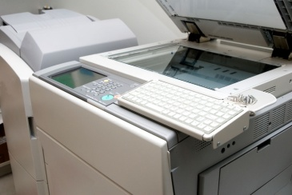

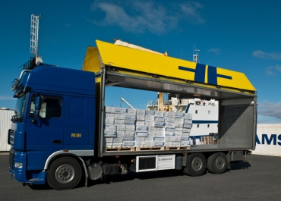
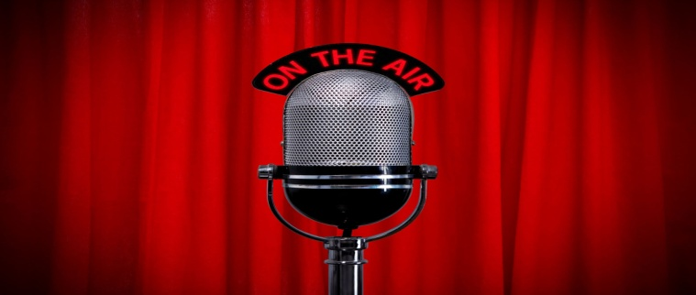

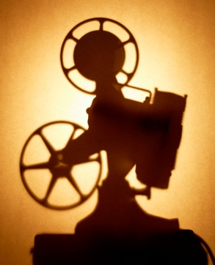
If you own a copyright, what do you own?
Reproduce
Create a derivative work
Distribute copies
Perform publicly
Display publicly
Perform in a digital transmission
Notes:
US copyright law enumerates six exclusive rights.
Exclusive in the active sense, of excluding. These rights are fences around the copyright owner’s property.
However, the scope of copyright isn’t completely limited to the rights that the Act enumerates – in the language of the law, the list is illustrative.
This is one way in which US copyright still differs from what prevails in Europe and elsewhere, BTW.
So all of these rights initially owned by the creator, meaning that the creator can sell, give away, or give up these rights. But let’s make that a little more concrete.

Slide 39

Notes:
Here’s an author who’s written a book.
As the creator of the content, she owns all of the rights to it.
She can make all of the copies of the work that she wants, and sell or license them to people on whatever terms she specifies.
She can also authorize other people, publishers or ebook retailers, to do anything that she can.

Slide 40
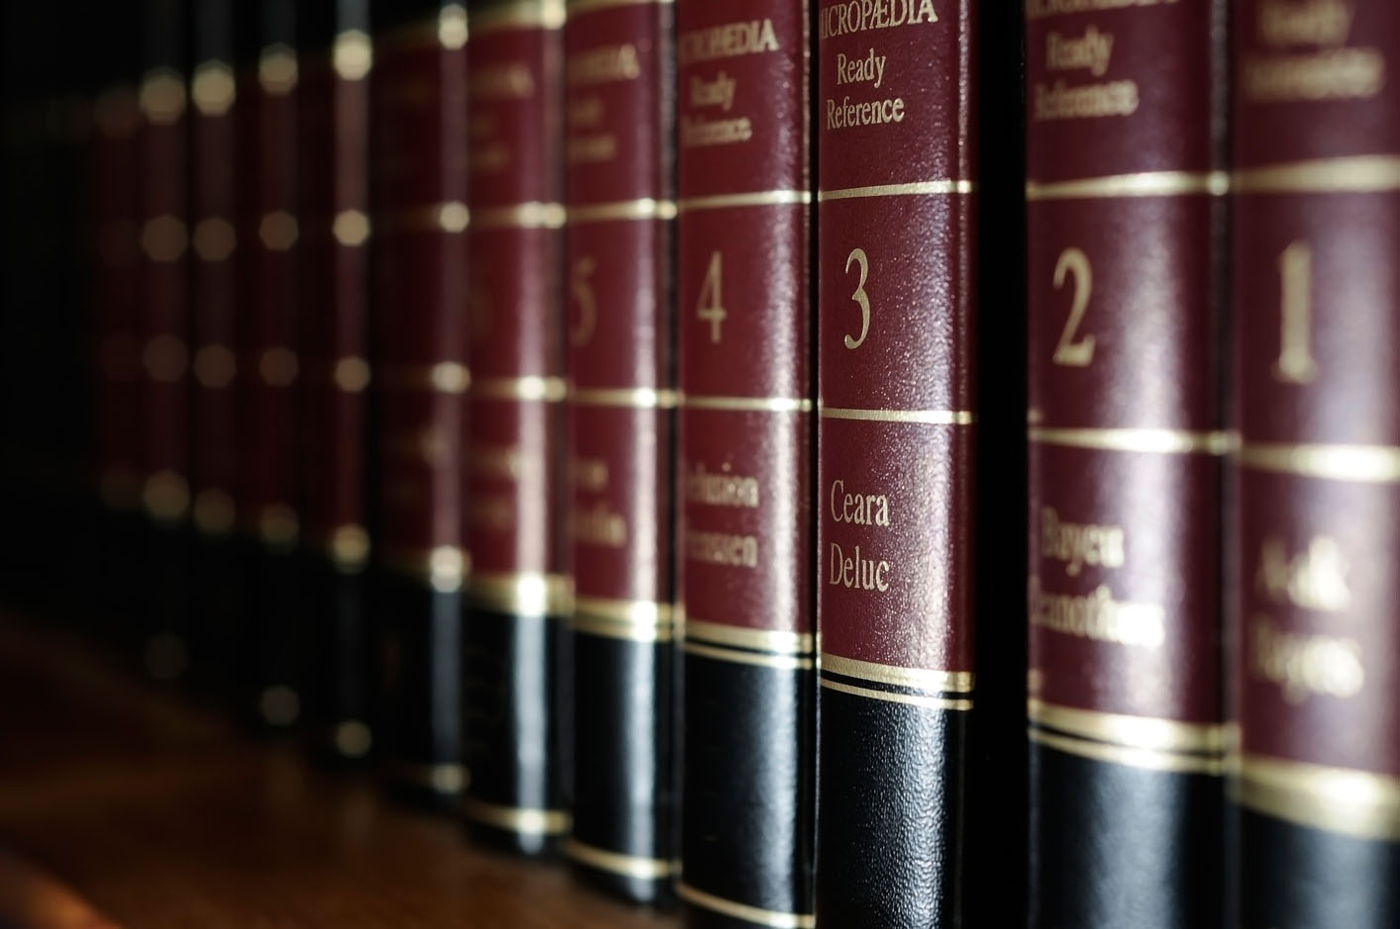


Reproduce
Notes:
First, there are rights to reproduce the copyrighted work.
These rights are infinitely divisible – as narrowly defined as the owner pleases.
In practice, we might see hardcover, paperback, and ebook rights.

Slide 41


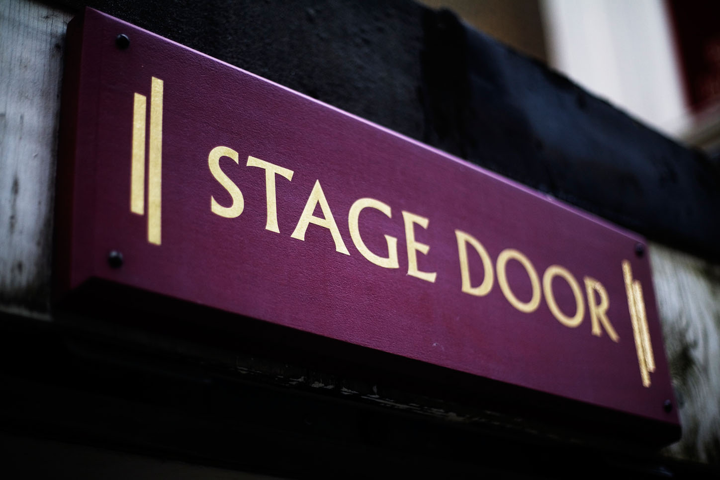
Create Derivative Work
Notes:
A derivative work is created from another work, in whole or in part.
For a book, obvious examples include audiobooks, which combine a performance with the original text of the book.
Or a movie, or a stage play.
This right is also frequently used – or abused, depending on your point of view – in mashup or appropriation works. One example might be the famous Shepherd Fairey Obama/HOPE poster, created by modifying a copyrighted photo.

Slide 42
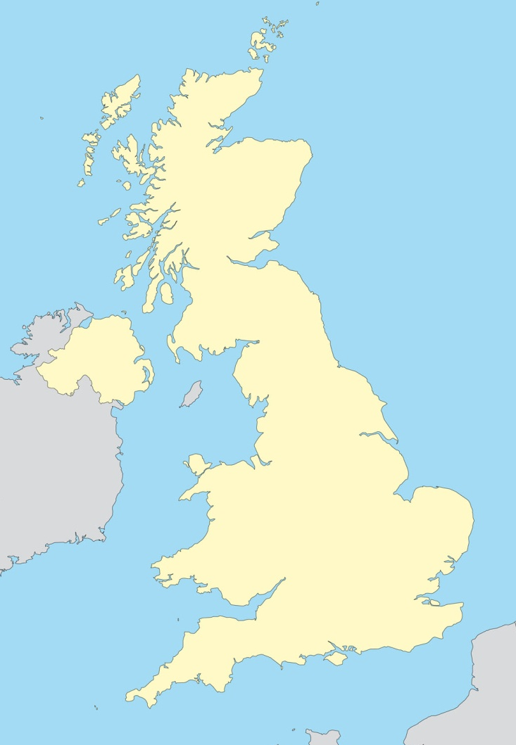
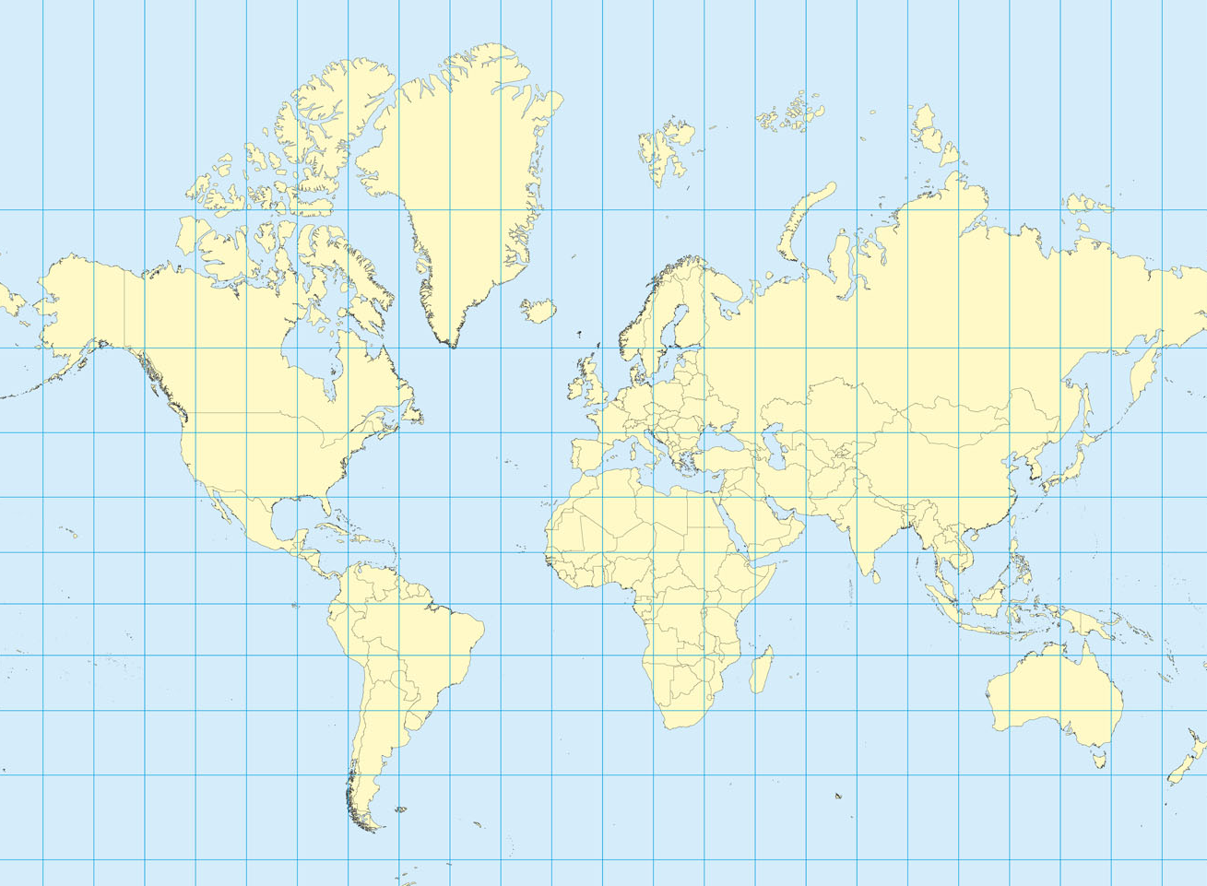
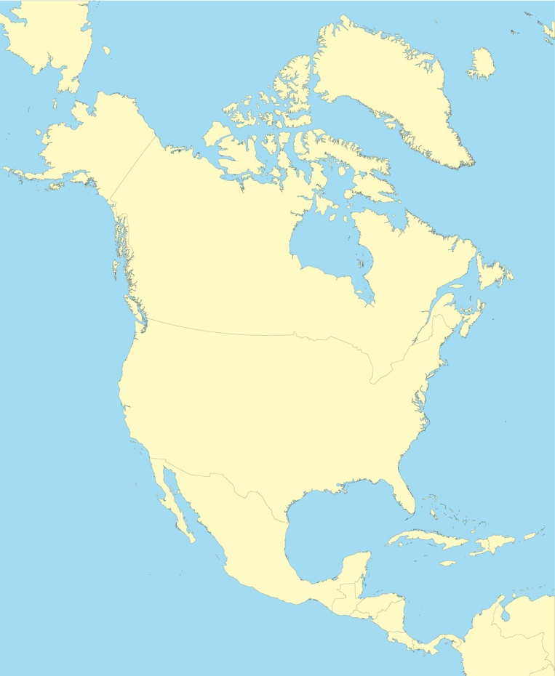

Distribute
Notes:
So now, the DISTRIBUTION right.
Depending on her contract, her publisher might buy world rights, North American & UK, or just US rights only. Those rights are the rights to sell, rent, lease, or distribute copies in any other way. That’s territoriality.
But territoriality is only one way to slice the distribution pie. Other slices would be the mechanism for digital transmission. Current author/publisher contracts may enumerate a dozen or more specific digital transmission mechanisms, just to make sure that the publisher holds the license for new technologies that might come up in the future.

Slide 43





Perform publicly
Notes:
Now we get to public performance.
Public v. private – play a DVD of a movie in a restaurant, versus in a private home.
Performing publicly can also apply to movies and stage plays, choreography, or even reading aloud to an audience.
Huge volume of add’l legislation to permit & control cable, satellite, and digital retransmissions.
Performance right controls public, not private.
Also, many exceptions, educational in particular.

Slide 44
Display publicly
Notes:
So now, the public display right.
Display is very similar to performance, except it applies to stills and single images.
Some of the same exceptions apply, particularly in education.

Slide 45





Perform sound recordings
in a digital audio transmission
Notes:
The digital performance right was added to the previous five by the imaginatively named Digital Performance In Sound Recordings Act, or DPRSA, of 1995. It’s about internet radio and similar streaming services.
This right is complex and riddled with exceptions, as Congress attempted to preserve the commercial value of copyrighted music against various threats perceived in internet distribution, while also enabling new services and forms of expression to function.

Slide 46
The exclusive rights in US Copyright
Reproduce
Create a derivative work
Distribute copies
Perform publicly
Display publicly
Perform digitally
Notes:
So these are the exclusive rights, the activities that copyright owners are able to control.
Exclusive is meant in a very strong sense, the ability to prevent others from exercising the active, even suing.
These rights represent the ability for the rights owner to require permission – and probably compensation – from potential rights users. Adding a right to this list means that an activity that possibly might have been permitted implicitly before, now becomes explicitly prohibited without permission.
This list, remember, is called out in the law as being illustrative. That means that the law does not inherently limit rights to those in the list.
In everyday business dealings in copyright, we’re usually combining one or more of these rights together in a license, but we’re almost never transferring the whole right in anything away. We can divide any of these rights as finely as we please, to suit whatever business arrangement we want to enable.
This is because rights are infinitely divisible.

Slide 47
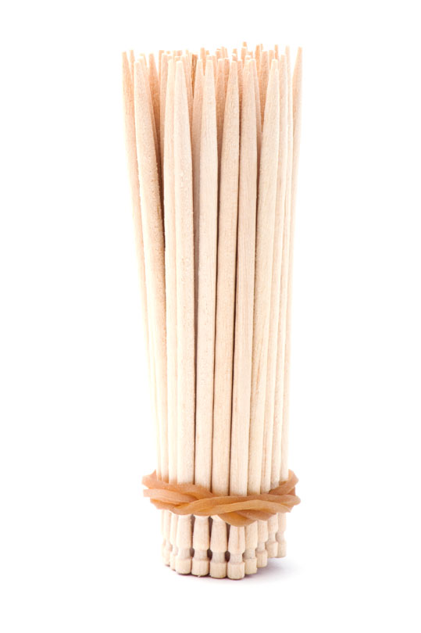
Divisibility of Rights
Bundle of rights
  Infinitely divisible
Each “stick” may be separately transferred
Transfers may be in whole or in part
Notes:
Classic metaphor – bundle of sticks.
DISTRIBUTE right
Subdivided into different territories, like US, North America, or World English rights.
Similarly, the DERIVE, or adaptation, right can be used to assign translation rights by language, or movie rights, or even movie rights by language.
But there are no limits to the subdivision of rights. Potentially, a copyright owner could sell French-language translation rights in Bulgaria
for all of the chapters contain the word “rutabaga.”
Review some cases in practice.

Slide 48
AUTHOR CONTRACT
Example 1:

Slide 49
Reproduce
Author grants exclusive …
Print
Audio
Electronic
rights…
Notes:
Obtained a typical current author contract for a big 6 publisher.
Analyzed the grant of rights section against the Copyright Act.
Exclusive – publisher will become the holder of the granted rights.
Will be able to sublicense, and also to sue for infringement

Slide 50
Reproduce
…to…
Distribute
Publish
Distribute
Transmit
Deliver
Transfer
In the English language …
Market
Sell
Notes:
Quite a laundry list, eh?
“In the English language” is a limiting clause here. Not based on geographic limitations anymore.

Slide 51
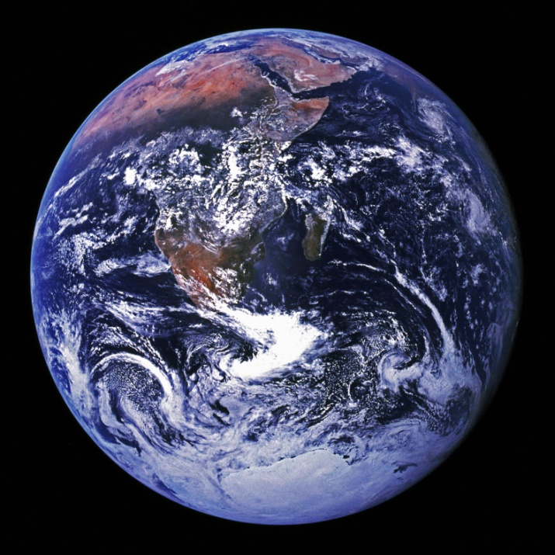
Distribute
…in any media…
currently available
invented in the future
…throughout the world.
(“The Territory”)
Notes:
We can thus infer that any lunar or Martian rights that become valuable during the term of copyright will be retained by the author.
Notice how much future-proofing is attempted in these few sentences. Publishers have learned over the last twelve years or so how important it is to acquire the rights for future technologies up front.

Slide 52
What’s not included?
Any performance or display rights
Notes:
The obvious would be movie or TV rights, which are DERIVE rights
The contract grants audio book rights, but not audio performance rights. Think about an ebook radio station, for example.
If an ebook radio station develops, the author or his agent could sell the “perform publicly over a digital transmission” right.
At least, that’s my reading of the text. The publisher’s counsel might disagree.
But it also makes sense – legitimate publishers don’t attempt to acquire “all rights,” because professional authors would never give those up.

Slide 53
E-READER TERMS OF USE
Example 2:
Notes:
[its the kindle!]

Slide 54
Reproduce
Content provider grants* non-exclusive
right to …
View
Use
Display
digital content [any] number of times…
for personal, non-commercial use.
*This is a license, not a sale.
Notes:
First, the grantor is the Publisher – the eReader company isn’t the rightsholder.
There’s some additional language about the case where the eReader company is also the Publisher.
The grant is non-exclusive – the user of the eReader device doesn’t get to prevent anyone from doing anything- doesn’t become a rightsholder herself.
The granted rights aren’t the ones in the list of exclusive rights
–thin little twigs pulled out of the infinite bundle.
Personal, non-commercial – you don’t get to rent the use of a book on your eReader. We’ll talk a little more about non-commercial use when we discuss Creative Commons, in the second session.
The asterisk’d point is important – you acquire digital content on the device under license content provider, not in the manner of buying a hard copy from a bookstore.

Slide 55

First Sale and eBooks
Notes:
By the way, the way that you acquire hardcopy books today is more complicated than you may be aware.
You buy a book at retail, where the price is set by the store. If you buy the new Reacher novel at B & N, you get their price.
Or you can buy it at a used book store at a much lower price, after someone turned it in for credit.
You could also sell it at your own garage sale for a lower price still. It wasn’t always like that!
At one time, copyright holders in the US asserted under copyright the right to control the sale price of a book wherever it was sold.
In 1908, the Supreme Court considered exactly such a question in Bobs-Merrill Co. v. Straus, determining that the publisher’s rights to control the price did not extend beyond the first sale. Section 109 of the ‘76 Copyright Act establishes in law that the owner of a legal copy is entitled to sell it without permission.
That’s why these terms are careful to characterize the transfer of content as a non-exclusive license instead of a sale.
Digital is different – you can’t really move bits from one place to another, you can only make a new copy and delete the original.
Can’t enforce the deletion!
Even physical property ownership is a bundle of rights, though, and you don’t get all of them.

Slide 56
Rights in Cars v. Rights in Copyright
If you buy a Car, you may… | If you buy a hardcopy Book, you may…
Sell it | Sell it
Destroy it | Destroy it
Lend it or rent it | Lend it or rent it
If you buy a Car, you may NOT… | If you buy a hardcopy Book, you may NOT…
Change the odometer | Claim you wrote it
Make copies of it | Make copies of it
Notes:
Back to the ebook reader terms

Slide 57
Reproduce
With certain limitations:
Sell
May not:
Rent
Lease
Distribute
…any rights to the digital content
Broadcast
Assign

Slide 58
What else?
You may not bypass or circumvent any security features that protect the digital content.
Notes:
This is the first time we’ve run into what’s become known as DRM, or digital rights management, technology.
We’ll go into more depth on that in the second session, as well.

Slide 59
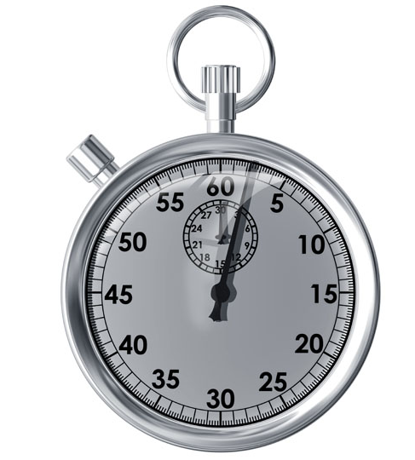
Copyright Term

Slide 60
US Copyright Term Since 1790
Law | Term
Copyright Act of 1790 | 14 + 14
Revision of 1831 | 28 + 14
Copyright Act of 1909 | 28 + 28
Copyright Act of 1976 | Life of Author + 50 years Works for Hire 75 years
Sonny Bono Copyright Term Extension Act of 1998 | Life of Author + 70 years Works for Hire 95 years
Notes:
Per Constitution, copyright term must be limited, but doesn’t say how long.
Over time, the term of copyright has expanded.
For works published after 1923, determination of the copyright status of a work can be quite complicated.
Factors like country of original publication, renewal status of the work, the particular year of publication, and whether it was created as a work for hire all affect the copyright status.

Slide 61
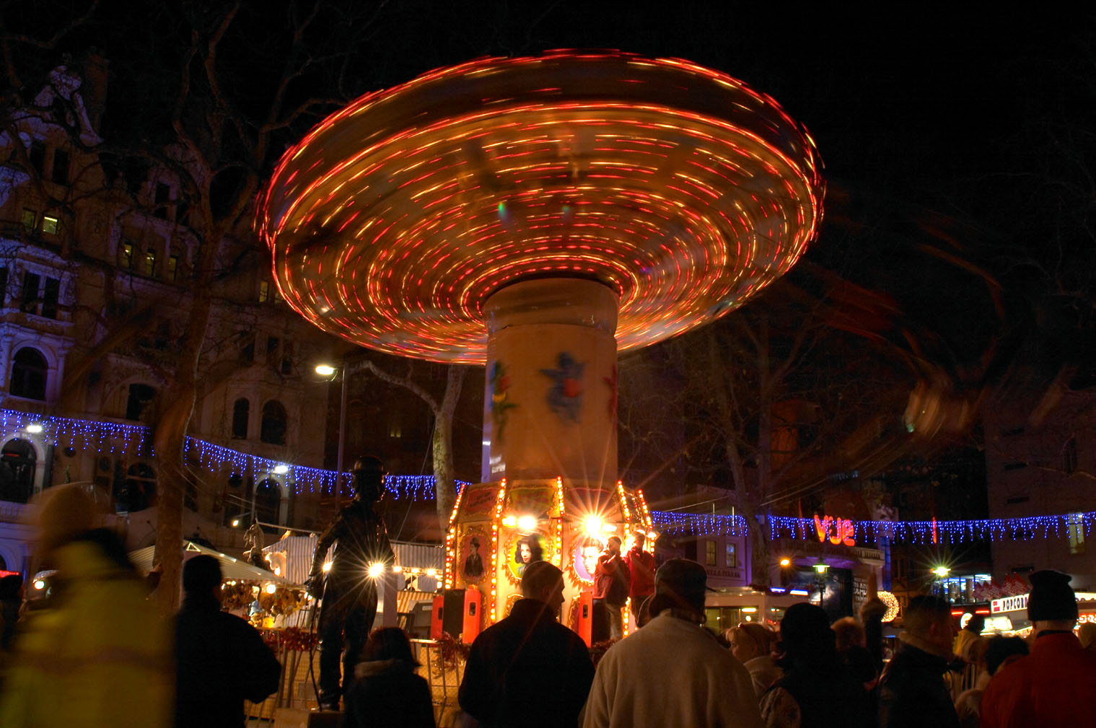
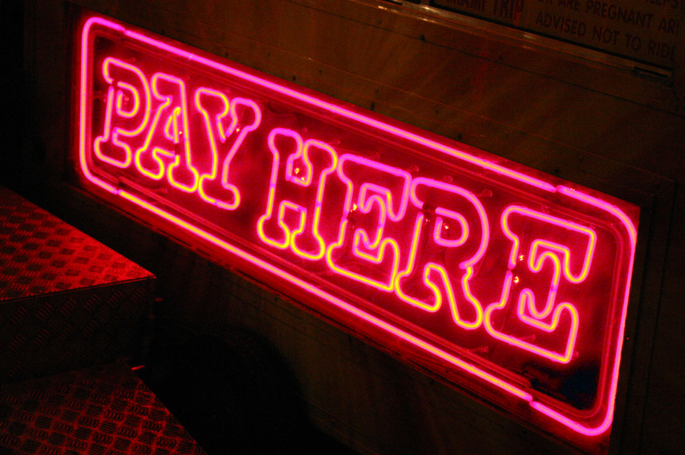
Fair Use
Notes:
Last topic before break.
Fair use is another copyright topic that spurs arguments.
To help us learn what kind of things fair use applies to, let’s start by taking a look at the law.

Slide 62

Origins of Fair Use
Notes:
If we go back to the Statute of Anne, the original law was quite simple. The Statue of Anne held that it was important to encourage the creation of original works, and for that reason
the creator of a work could forbid other people from making copies of it.

Slide 63


Notes:
English courts interpreted the strict prohibition in light of its stated purpose.
CLICK
Thus parody and satire were permitted to reproduce some elements of a work without permission.
CLICK
Take a book, make it shorter?
A 1740 case in England – Gyles v Wilcox – suggested that some kinds of abridgement would be permitted, as long as they required some kind of editorial discretion.
In the US in 1840, Folsom v. Marsh in the United States considered whether to allow an abridgement of a biography of George Washington that essentially omitted a huge volume of material, but retained the rest verbatim.
The resulting decision by Justice Story associated the phrase, “fair use,” with a new multi-factor test that has persisted with minor clarifications to this day.
However, it was not until the Copyright Act of 1976 that US law included any specification of what fair use was. Let’s take a look at that.

Slide 64
Fair Use in Section 107
A Fair Use for
  Criticism
  Comment
  News reporting
  Teaching (including multiple copies for classroom use)
  Scholarship
  Research
Is not an infringement of copyright.
Notes:
It’s important to read this carefully – it’s not a list of things that are fair use. It’s “a use that is fair, that takes the form of…”
The bullets are best read as a sort of “for instance.”

Slide 65
To determine whether a use is fair, consider…
Purpose and character of the use
  Commercial
  Non-profit educational
Nature of the work
How much of the work is used
Effect of the use on the
  Value of the work
  Potential market for the work
§107 · Limitations on exclusive rights: Fair use
Notes:
However, those activities aren’t automatically permitted. To determine whether a use is fair, you consider four factors:
Now at first, this sounds like a really clear way to figure out whether you can make a copy.
Overall, though, it’s hard to look at the Factors as if they were rights that a consumer of content can rely on.
For one thing, they’re not written as guarantees, but as tests of infringement. That alone implies that judgment will be important on a case by case basis.
But there are challenges, the moment you scrape below the surface.
For instance, is commercial use actually the opposite of nonprofit educational use?
What about for-profit educational use?
What if a non-profit sells educational materials?

Slide 66
1. Nature of the Use
Commercial | Non-profit educational
Less likely to be fair use | More likely to be fair use
Notes:
Don’t seem like opposites, phrased like this.
What about for-profit education?
One way to look at it is as more of a continuum. Activities that are close to non-profit, or that are close to educational, are the most likely to be fair use.
However, fair use is not intended to enable a user of a copyrighted work to make a profit from it without paying a rightsholder.
It could go the other way, too.
Hustler Magazine published a fairly nasty feature about Jerry Falwell. Falwell responded by printing millions of copies and distributing them for fundraising. Hustler sued for copyright infringement, but the use was allowed as a legitimate response to derogatory material.
Another point to consider is whether the nature of the use was Productive or Transformative.

Slide 67
2. Nature of the Material
Purely for entertainment | Educational
Less likely to be fair use | More likely to be fair use
Notes:
What does the nature of the material have to do with anything?
For one thing, copyright exists to support the public interest by increasing the supply of information.
Fair use is more easily allowed in where the material is educational, scientific, or factual than when it is just for entertainment.
Also, unpublished works enjoy greater protection against fair use than published ones.
However, like everything else in fair use, this isn’t an absolute rule either; Section 107 itself says so.

Slide 68
3. Amount of portion used
The whole or most significant part | Minimal to achieve the purpose
Less likely to be fair use | More likely to be fair use
Notes:
The closer the copying comes to reproducing the whole work, the less likely the use is to be fair.
Some might try to make rules – is 10% always OK? 5%?
Sometimes a small portion is hugely important – Zapruder film, a key excerpt from a Ford’s biography.

Slide 69
4. Effect on the potential market or value
Substantial impact to value or sales | No lost sales
Less likely to be fair use | More likely to be fair use
Notes:
Now let’s take a look at a couple of real-world examples.

Slide 70
Four Factors in Righthaven v. Hoehn
Nature of Use | Nature of Material | Extent of Copying | Market Effect
Noncommercial, uncompensated commentary | Editorial, mostly factual material |  | “Righthaven has not presented evidence of harm”
 |  | Copied entire work
Fair use
Righthaven LLC v. Wayne Hoehn, Case 2:11-cv-00050-PMP -RJJ Document 28

Slide 71
Four Factors in UMG v. MP3.com
Nature of Use | Nature of Material | Extent of Copying | Market Effect
Commercial Verbatim Non-transformative | Entertainment | Copied entire works – CD’s | UMG was already making licensing arrangements for similar services
Compelling argument against fair use
  No real fair use case under four factors
Notes:
The judge in UMG v. MP3.com found little ground for finding fair use in anything MP3.com did.
The purpose was commercial, since MP3.com wanted to sell ads
, the material was entertainment, which makes it harder to find fair use
Crucially, UMG was able to show that it was trying to sell licenses to copy collections of CD’s for streaming purposes, which indicated that there was potential harm.
When you read the case, it’s clear that the fair use argument wasn’t even close to succeeding.
And that was most of MP3.com’s case.

Slide 72
Fair Use – Points of View
Notes:
Controversy, philosophical disagreements over the nature, importance
Quotes from two eminent scholars of copyright

Slide 73
“In determining … copyright infringement, the courts have long recognized that certain acts of copying are defensible as
fair use.”
Nimmer, Melville and Nimmer, David,
Nimmer on Copyright, 13.05
Notes:
It could be said that this is an accurate description of the nature of fair use in the United States today.
It is not a Bill of Rights for the allowable use of copyrighted material.
It’s a defense against a charge of copyright infringement, an affirmative defense that acknowledges that an activity that might infringe copyright has occurred.
Nimmer on Copyright is the standard reference on copyright law, frequently cited alongside prior cases in legal opinions on copyright cases.

Slide 74
“Fair use must be viewed as an integral part of the system, not an … exception to a Hobbesian state of nature
where ruthless enforcement of exclusive rights as private property is the ideal.”
Patry, William, Patry on Copyright, 10:2
Notes:
William Patry is also an eminent legal scholar who has also produced a landmark legal reference to copyright law.
He brings a different perspective to copyright, having served for years in the legislative branch, as well in corporate law.
He is currently Senior Copyright Counsel at Google.

Slide 75
Copyright Summary, Session 1
Originates with the creator
Applies to original works that are fixed in a tangible medium
  Text, Images, Music, Motion Pictures, Choreography, Drama, and Architecture
Consists of a set of exclusive rights
  Reproduce, Derive, Distribute, Perform, Display, Transmit Digitally
  That are infinitely divisible
  Limited in term
With exceptions like Fair Use
  But many more!

Slide 76
BREAK
In the next session:
  International Copyright
  Change and Copyright

